Slide 1
SCENE RECONSTRUCTION
Using Latent Space Interpolation of Variational Auto Encoders (VAE)

Slide 2
CONTENTS OF PRESENTATION
INTRODUCTION
DATA SET DESCRIPTION
VAE THEORY
PROJECT WORK
SAMPLE RESULTS

Slide 3
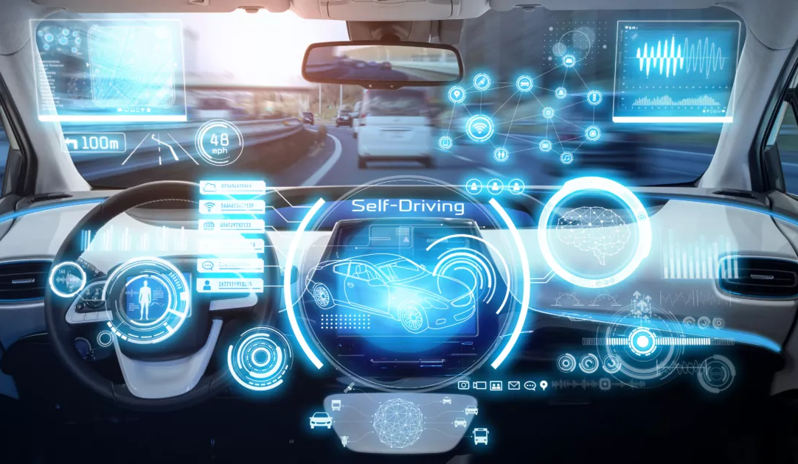
INTRODUCTION
In the contemporary world there is a huge need for High Tech based vehicles which includes Automation of Cars. In Automation of cars, Machine Learning plays a vital role for controlling the car functions based on what objects it sees around. The examples could range from stopping at a signal or accelerating on high-speed roads to using different speeds during weathers, traffics etc.
In this Project, we try to use image datasets taken from Cars during different distinct weather conditions and using the power of Latent Space interpolations to generate new images of mixed weather conditions which can serve as a great data for training autonomous cars for such mixed weather conditions.

Slide 4
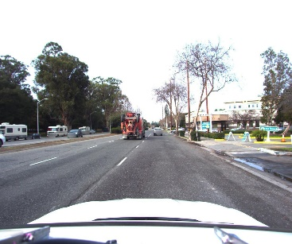
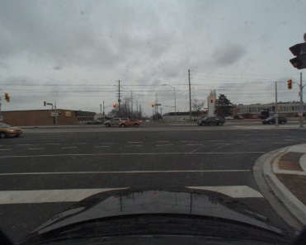
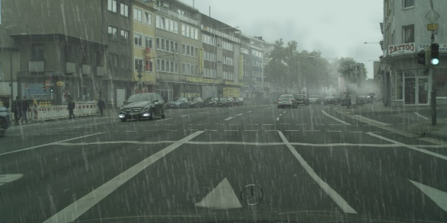
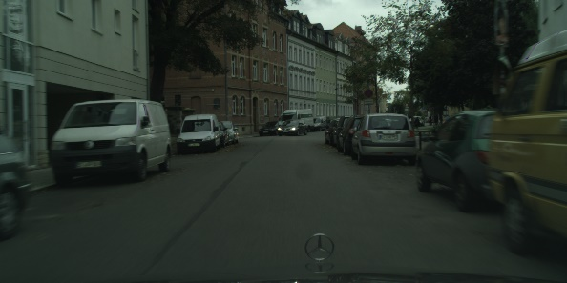
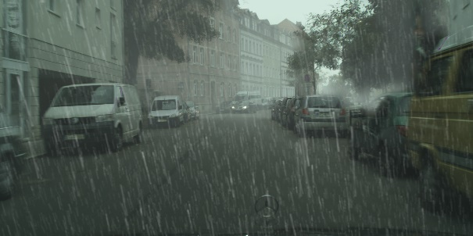
DATASET DESCRIPTION
There were 2 kinds of datasets used.
The First one consists of 90 Images out of which 30 images are taken on Sunny days, 30 images are taken on cloudy days and the rest 30 images are taken on rainy days. The Image is in general with different pixel sizes of the orders of 1024-2048 pixels.
The dataset consists of 490 Images out of which 245 images are taken cloudy days and the rest 245 images are taken on rainy days. The images are taken at exact same location. So there 245 places where both a rainy and a cloudy image is taken. The Image is in general with pixel size of the of 1024 pixels high and 2048 pixels wide.
Sunny Cloudy Rainy
Cloudy Rainy

Slide 5
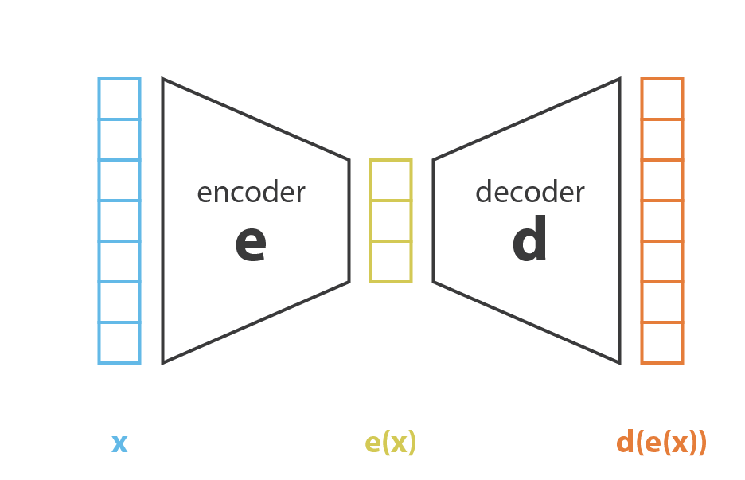
Variational Auto Encoder (VAE)
Auto Encoders:
In general, the images are of greater sizes, however when we use Neural networks we can try to reduce the image size while retaining most of its features. This type of compression that we use here is called Latent Space Encoding.
The structure of a typical Autoencoder is as shown beside:

Slide 6

Variational Auto Encoder (VAE)
Latent Space Interpolation:
Latent Space : The ‘e(x)’ encoded space is known as the Latent Space.
Interpolation : Interpolation refers to interpolating (finding points in between) between two given inputs ‘x₁’ and ‘x₂’.
Instead of interpolating right between the direct inputs ‘X₁’ and ‘X₂’, we use the latent space encoded ‘n’ dimensional values for these inputs and interpolate between them.
For inputs say x₁ and x₂ , let the encoder give outputs : e(x₁)=e₁ and e(x₂)=e₂ , where e₁ and e₂ belong to e(x) space.
Suppose we need ‘k’ latent space images then the i^{th} image between e₁ and e₂ is given as :
Where the 0th image is e₁ itself and the k_{th} image is e₂ itself.
$$e_{1−2,i}=\left(1−\frac{i}{k}\right)e_{1}+\left(\frac{i}{k}\right)e_{2}$$

Slide 7
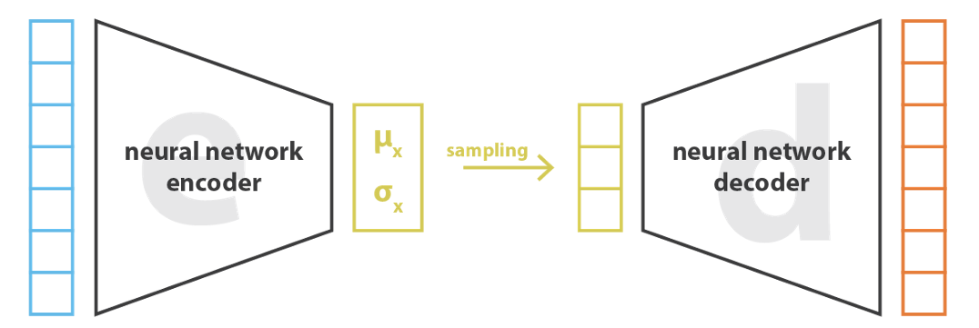
Variational Auto Encoder (VAE)
Variational Auto Encoders:
A Variational Autoencoder can be defined as being an autoencoder while training is regularized to avoid overfitting and ensure that the latent space has good properties that enable decoding in a fruitful way.
Instead of encoding an input as a single point as we were doing in Autoencoders, here we encode it as a distribution over latent space.

Slide 8
Variational Auto Encoder (VAE)
Loss Function:
The Loss Function of a Variation Autoencoder consists of 2 parts.
Generative loss: This loss compares the model output with the model input. This can be the losses we use in the autoencoders, such as L2 loss.
Latent loss: This loss compares the latent vector with a zero mean, unit variance Gaussian distribution. The loss we use here will be the KL divergence loss. This loss term penalizes the VAE if it starts to produce latent vectors that are not from the desired distribution.

Slide 9
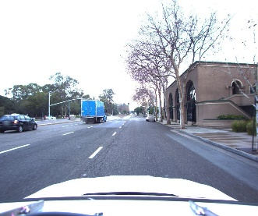
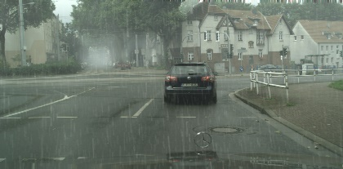
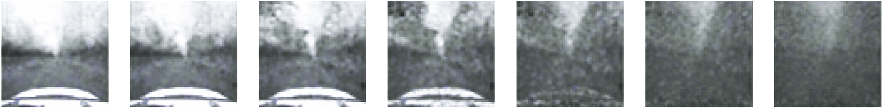
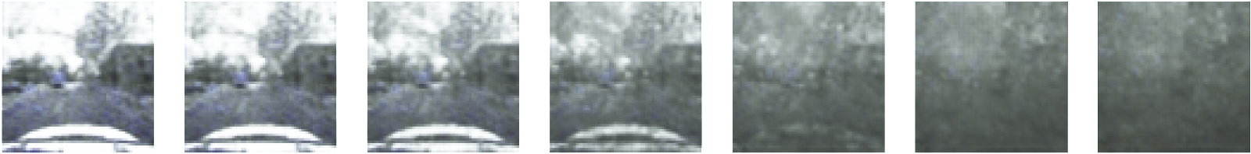
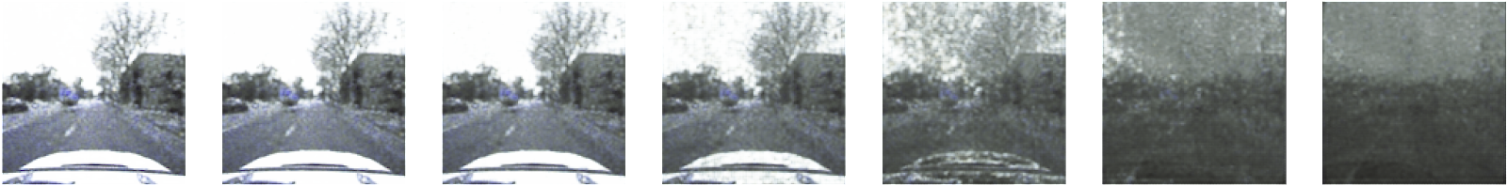
Work Done
Dataset 1:
Since the images in the dataset were of very different sizes, I did the entire project on this data by resizing the data to 1:1 aspect ratio.
64 x 64 x 3
64 x 64 x 3
128 x 128 x 3
2 Dimensions
20 Dimensions
20 Dimensions

Slide 10
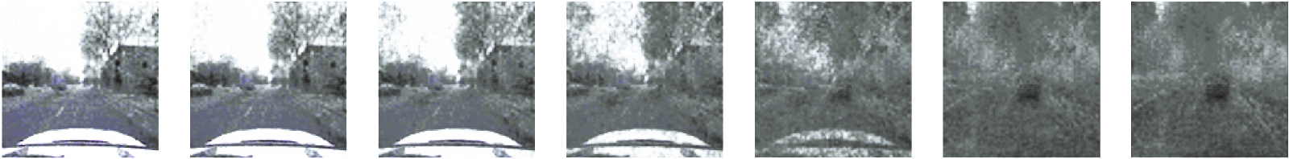
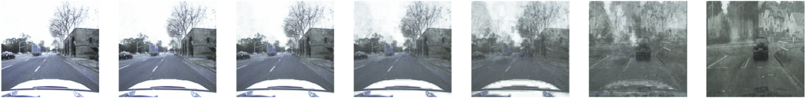
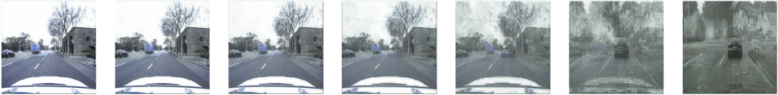
Work Done
Dataset 1:
Since the images in the dataset were of very different sizes, I did the entire project on this data by resizing the data to 1:1 aspect ratio.
128 x 128 x 3
256 x 256 x 3
512 x 512 x 3
40 Dimensions
40 Dimensions
60 Dimensions

Slide 11

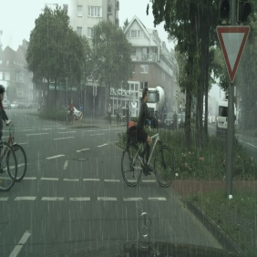

Sample Results
Dataset 1:
Since the images in the dataset were of very different sizes, I did the entire project on this data by resizing the data to 1:1 aspect ratio.
SUNNY TO RAINY

Slide 12


Sample Results
Dataset 1:
Since the images in the dataset were of very different sizes, I did the entire project on this data by resizing the data to 1:1 aspect ratio.
CLOUDY TO RAINY

Slide 13


Sample Results
Dataset 1:
Since the images in the dataset were of very different sizes, I did the entire project on this data by resizing the data to 1:1 aspect ratio.
CLOUDY TO RAINY

Slide 14
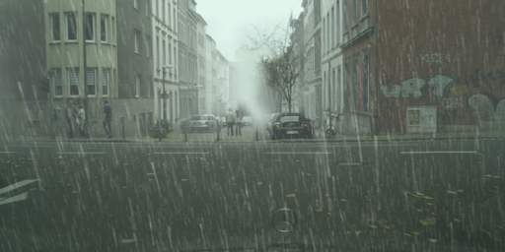
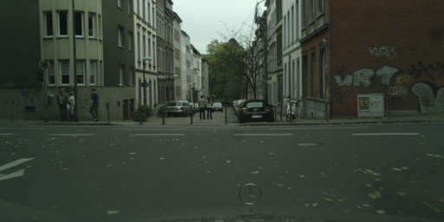


Work Done and Sample Results
Dataset 2:
Since the images in the dataset were of fixed size (1024 pixels high, 2048 pixels wide), I did the entire project on this data by resizing the data to 1:2 aspect ratio. (Specifically 256 pixels high, 512 pixels wide)
RAINY TO CLOUDY

Slide 15
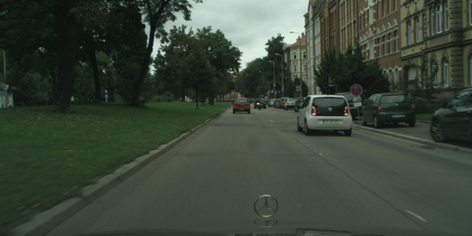
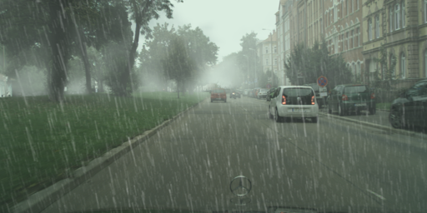


Work Done and Sample Results
Dataset 2:
Since the images in the dataset were of fixed size (1024 pixels high, 2048 pixels wide), I did the entire project on this data by resizing the data to 1:2 aspect ratio. (Specifically 256 pixels high, 512 pixels wide)
CLOUDY TO RAINY

